Slide 1


Welcome
Welcome
A strategic transportation plan connecting communities across North Carolina, focused on creating a more responsive, diverse, and inclusive transportation system for keeping people and freight moving safely and efficiently.
Notes:
Key Message: Welcoming and thanking everyone for their interest in getting involved in the NC Moves 2050 Plan
Suggested Narrative:
Welcome to the meeting for NC Moves 2050, North Carolina’s long range multimodal transportation plan. This plan is an important initiative for North Carolina and your participation is critical to its success. The purpose of this presentation is to inform, engage and generate excitement around this important initiative. This is an update on the planning efforts since the presentation in Spring of 2019.

Slide 2
Agenda
Future Needs
How to Get Involved
Plan Updates
Notes:
In this presentation we will be giving you an update on the development of the plan, go over the future needs, and wrap up with how you can continue being engaged in the planning process.

Slide 3
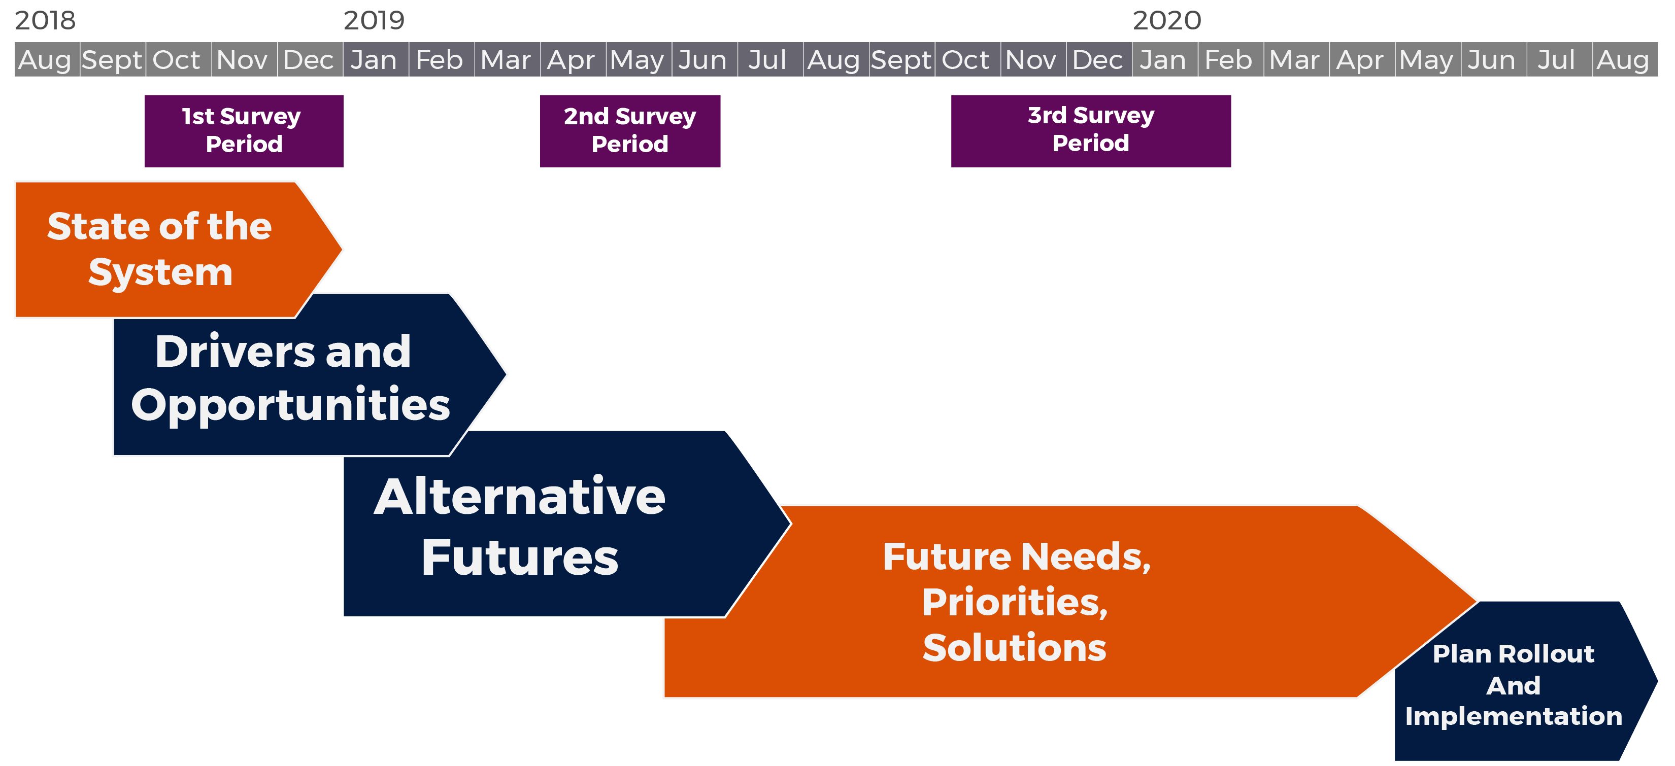
What has Happened since May?
Notes:
Key Message: Several key milestones have been reached since the last round of presentations.
Suggested Narrative:
Since the last round of presentations, the NC Moves 2050 project has reached several key milestones in the plan development. The research for the Drivers and Opportunity task was completed, the 4 alternative futures were developed and highlighted in the second survey, and most recently, the strategic actions to reach the NC Moves 2050 goals have been drafted and are the main content for the third survey.

Slide 4








Drivers and Opportunities
Finalized 8 topic-based fact sheets highlighting key trends and potential impacts covering:
Demographics
Partnerships
Security
Resiliency
Economy
Funding
Tourism
Technology
Notes:
Key Message: The Drivers and Opportunities task is complete, fact sheets can be found on the project website.
Suggested Narrative:
The research done on 8 topic areas, shown here, has been finalized and summarized through 8 fact sheets that highlight key trends and potential impacts that will effect North Carolina’s future. The fact sheets are a summary of technical papers developed. The fact sheets can be found on the website.

Slide 5
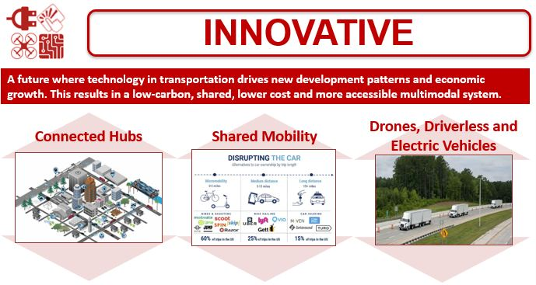

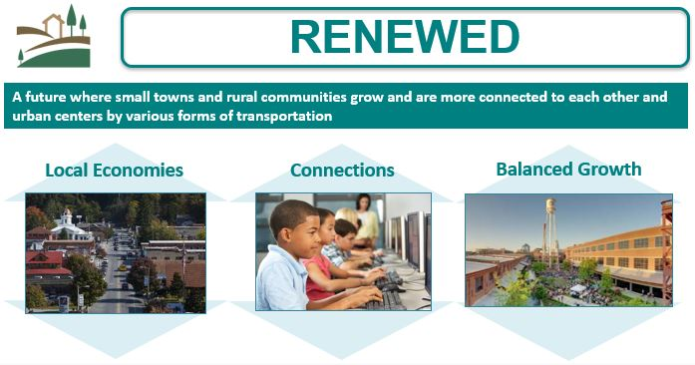
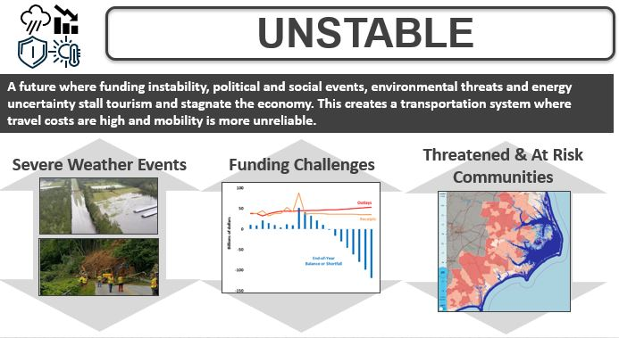
Alternative Futures
Notes:
Suggested Narrative:
The NC Moves 2050 Plan explored four different scenarios to help picture our transportation future. These scenarios help us understand what could happen, not predict what will happen. Scenario planning helps develop different views of the future based on “what ifs”. This helps the N.C. Department of Transportation better understand how to prepare long-range transportation plans that consider how people and goods will travel. There is more information on the project website, as well as a fact sheet.

Slide 6
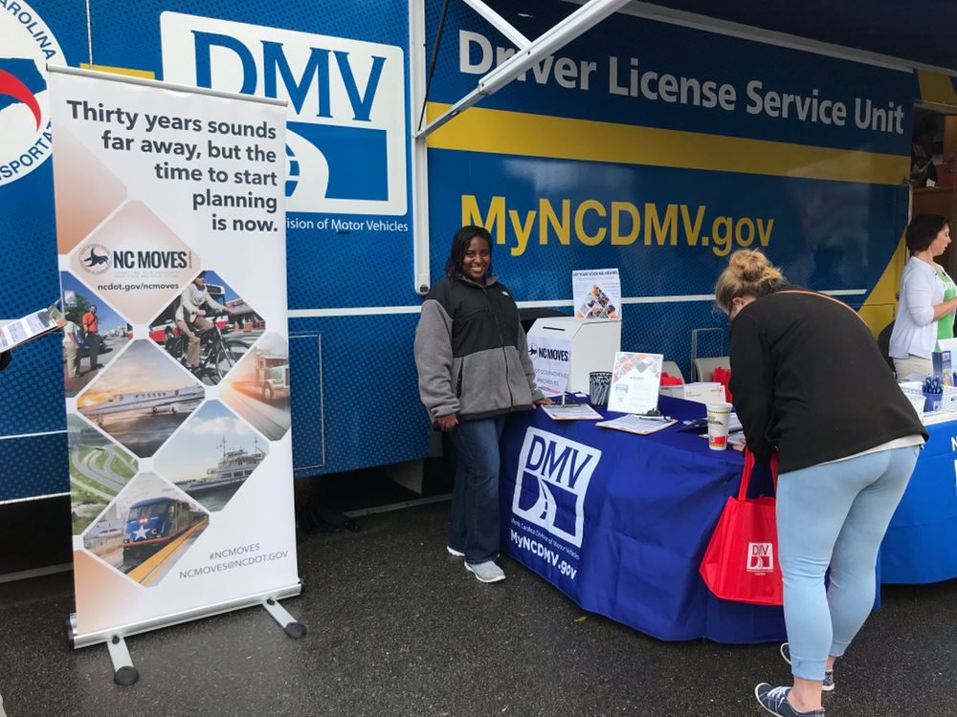
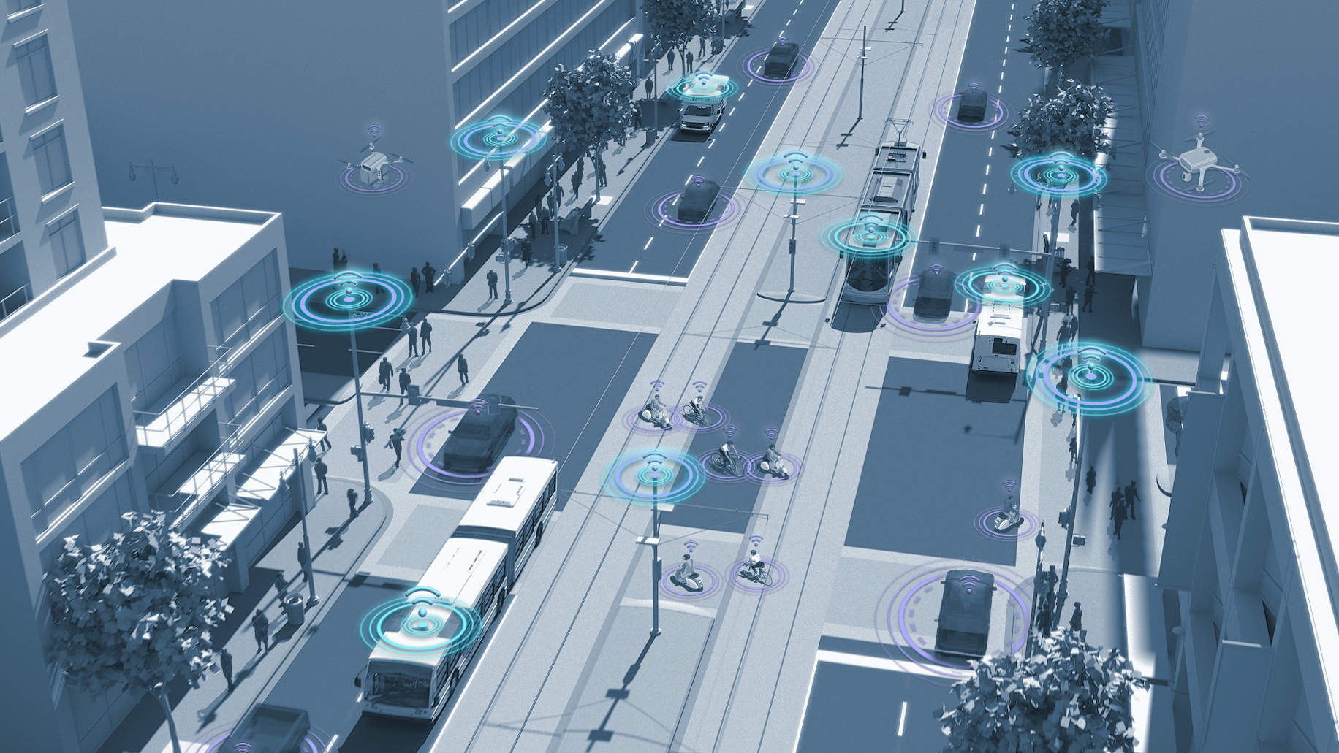
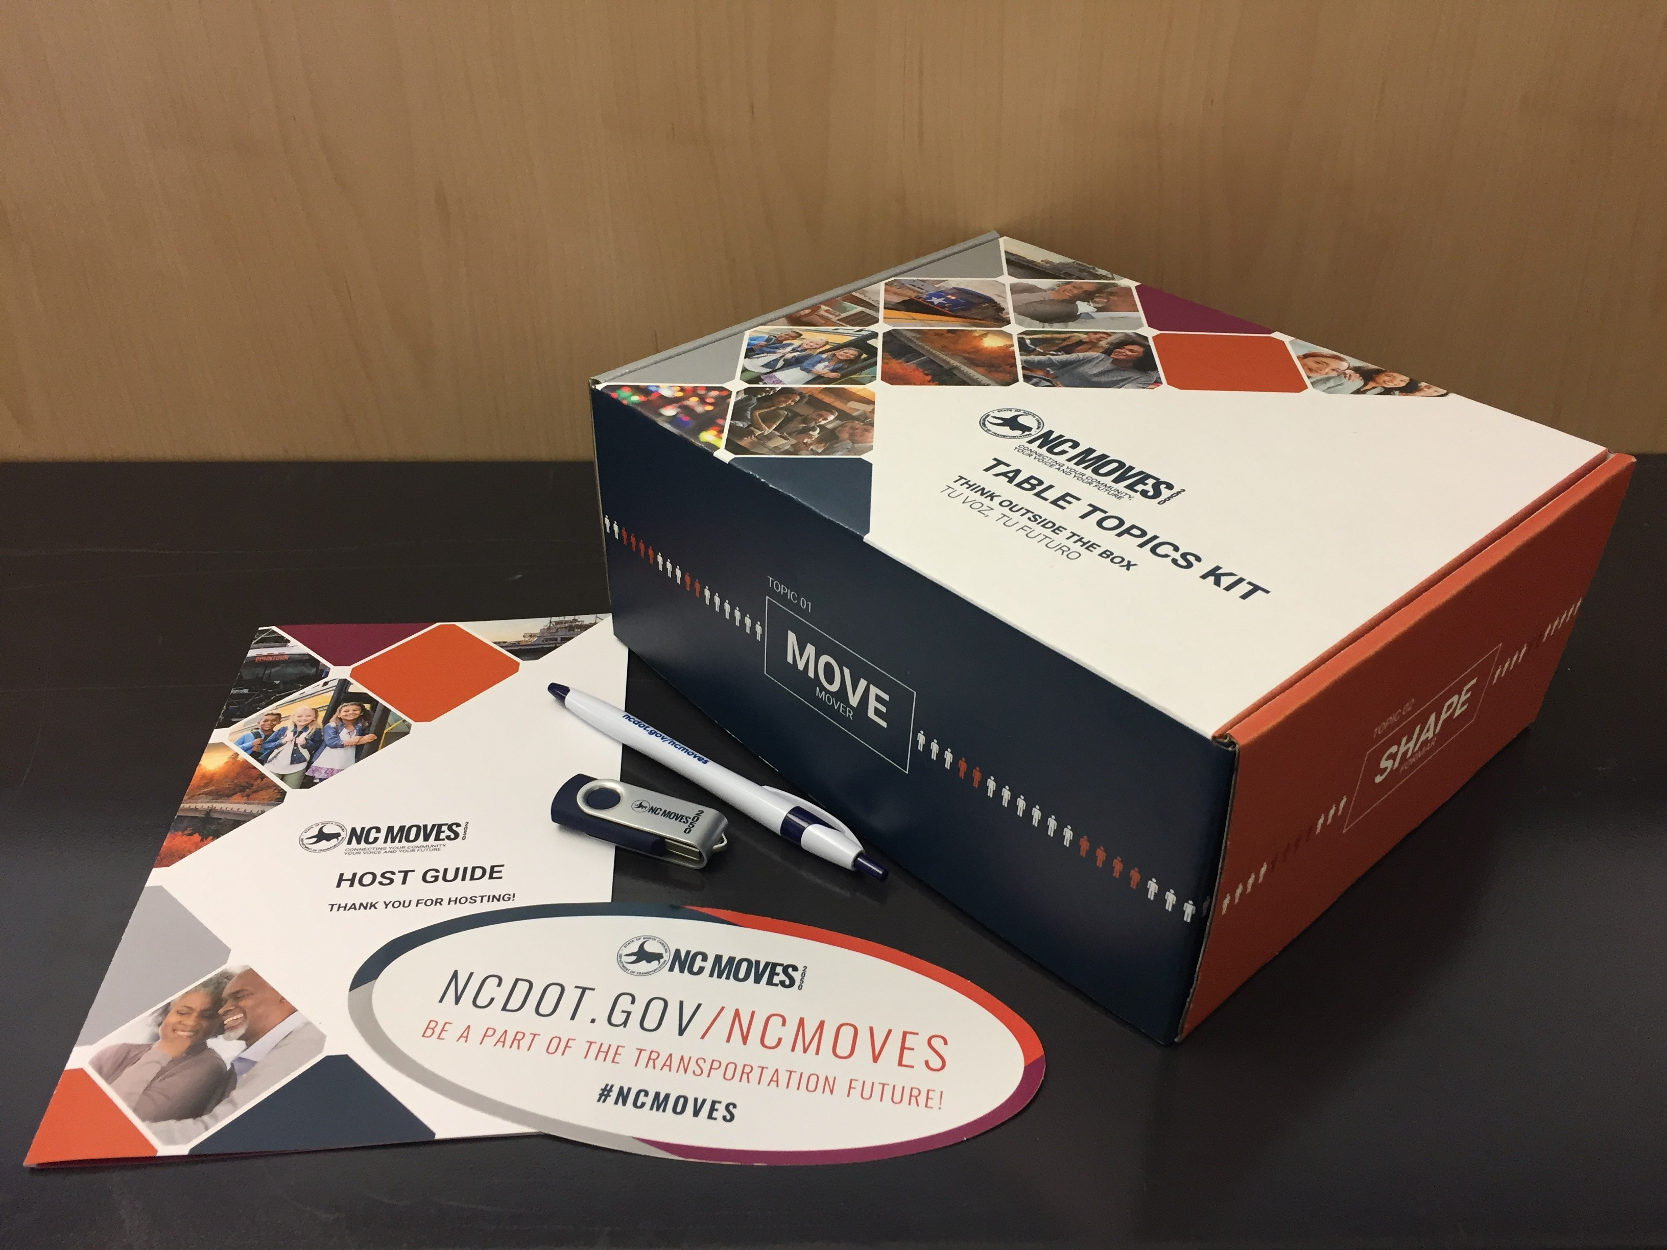
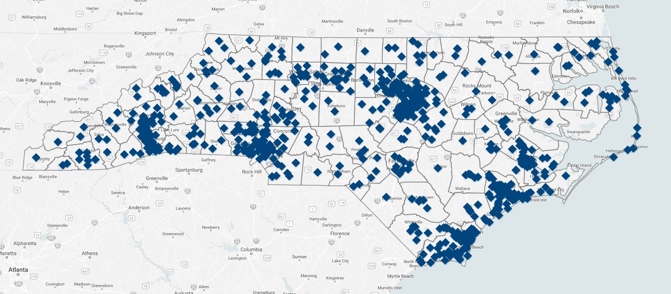
Phase II Engagement Accomplishments
Survey #2
  10,100 participants
  4,205 took survey on website
  2,880 took survey on phone
  3,015 paper surveys
  14,754 visitors on website
  325,902 data points
  929 comments
Table Topics
  18 Conversations held
  Over 100 participants engaged
  59% participants ages 18-29
  25% African American
  7% Hispanic
Public Comment Map
  Over 1000 comments received
  Comments made in all 100 counties
  70% of participants were residents
Outreach
  Attended
    7 college events
    9 conferences
    6 DMV events
    10 festivals
  Emailed 7,829 stakeholders
  Sent surveys to 15 county schools
  Placed 31 intercept survey boxes
6
Notes:
Key Message: The 2nd survey focused on the alternative futures and ran from April to June. Over 10,000 people participated.
Suggested Narrative:
The 4 alternative future scenarios were presented in the second survey, allowing the project team to collect input from the public on how they thought the future might look. The survey was taken by over 10,000 North Carolina residents. This input was used to help develop the needs for 2050 and to draft the NC Moves 2050 objectives and strategic actions. A summary of the second phase of engagement, including the results from the survey, can be found on the project website. Outreach for this phase was comprehensive and reached every county in North Carolina.

Slide 7
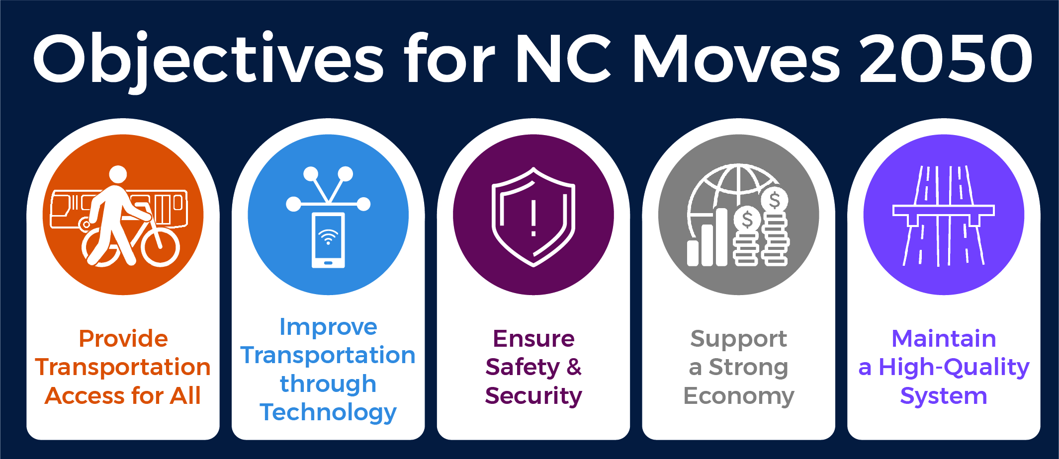
Planning for Future Needs
Notes:
Key Message: There are five objectives that will support the NC Moves 2050. These objectives are the focus of the 3rd survey
Suggested Narrative: There are five over arching objectives that support the needs of 2050 and the goal of the plan. THIS IS STATED TWICE
The vision of NC Moves 2050 will reflect NCDOT’s focus on policy-based solutions rather than specific projects. This means instead of making decisions like “building a bike lane on Main Street,” we would look to “provide support for local bicycle projects.” There are five objectives that support the vision of NC Moves 2050. Each objective is based on research of existing transportation plans and future needs. They reflect the feedback of residents, stakeholders, partners, NCDOT staff and subject matter experts.
The following slides show the different actions needed to support these objectives. The survey asks participants to select their top three example actions under each objective.
The survey acts as a good hand out to participants to understand each of the strategies better.

Slide 8
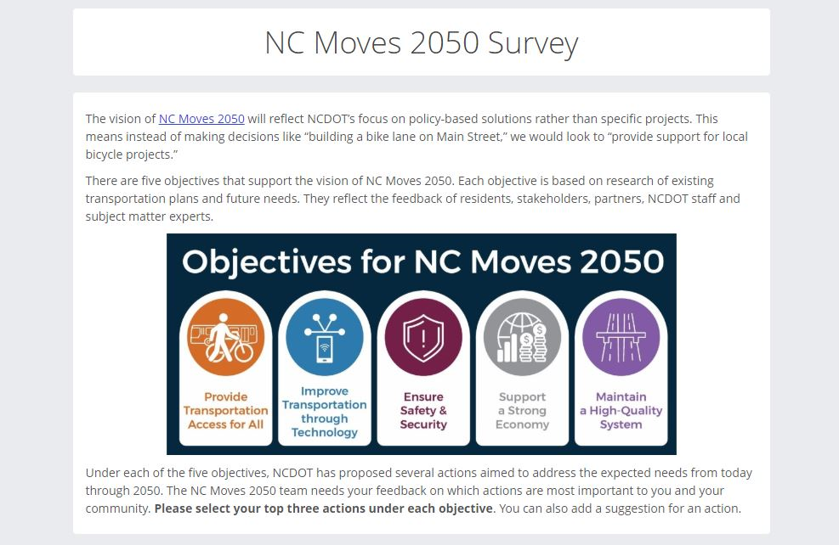
How to Get Involved:
Take the Survey!
Open Oct. 16 through Feb. 14
publicinput.com/ncmoves
Notes:
Key Message: Encourage participation in the current survey and ask participants to share the survey with their networks.
Suggested Narrative:
The third public survey is open from October 16th to February 14th and asks residents to give their input on which draft actions are most important to them and their communities. Please go online to take the survey and encourage your communities to do the same by sharing the survey with all your networks.

Slide 9
Stay Involved!
Promote NC Moves 2050
  #NCMOVES
  NCMOVES.GOV
  Follow us on Facebook, Twitter, Instagram
  Sign-up for Email Updates
Be a Voice and a Champion
  Inform
  Engage
  Generate Excitement
Notes:
Key Message: This lays out the plan development process, note that engagement is on-going throughout the planning process. There are many ways to get involved.
Suggested Narrative:
As mentioned earlier, more public engagement is coming this spring. This is our opportunity to continue to stay engaged and get our community to participate. Promote NC Moves 2050 by using the hashtag, visiting the website to learn more and find plan updates, following the plan on social media, sharing and re-posting NCDOT posts on Facebook and Twitter to reach your audiences, participate in future surveys, and sign up for email updates. We also encourage you to become a voice and champion for the plan so that you can inform the public, engage them in the process, and generate excitement about the plan. NCDOT thanks everyone for their time today to learn about this important project.

Slide 10

WWW.PUBLICINPUT.COM/NCMOVES
10
Notes:
Key Message: Promote engagement in the plan. Drive people to the website to learn more and encourage the use of the #NCMOVES
Suggested Narrative:
It’s very important that the public is continually engaged throughout the plan’s development. Transportation is changing rapidly and NCDOT wants to ensure that all people have transportation options for they need them. This plan will guide future transportation policies and investments, so it’s important that all residents have a chance to voice their needs and thoughts. More information about NC Moves 2050 can be found online at this web address or on social media using the #NCMoves hashtag.

